Slide 1
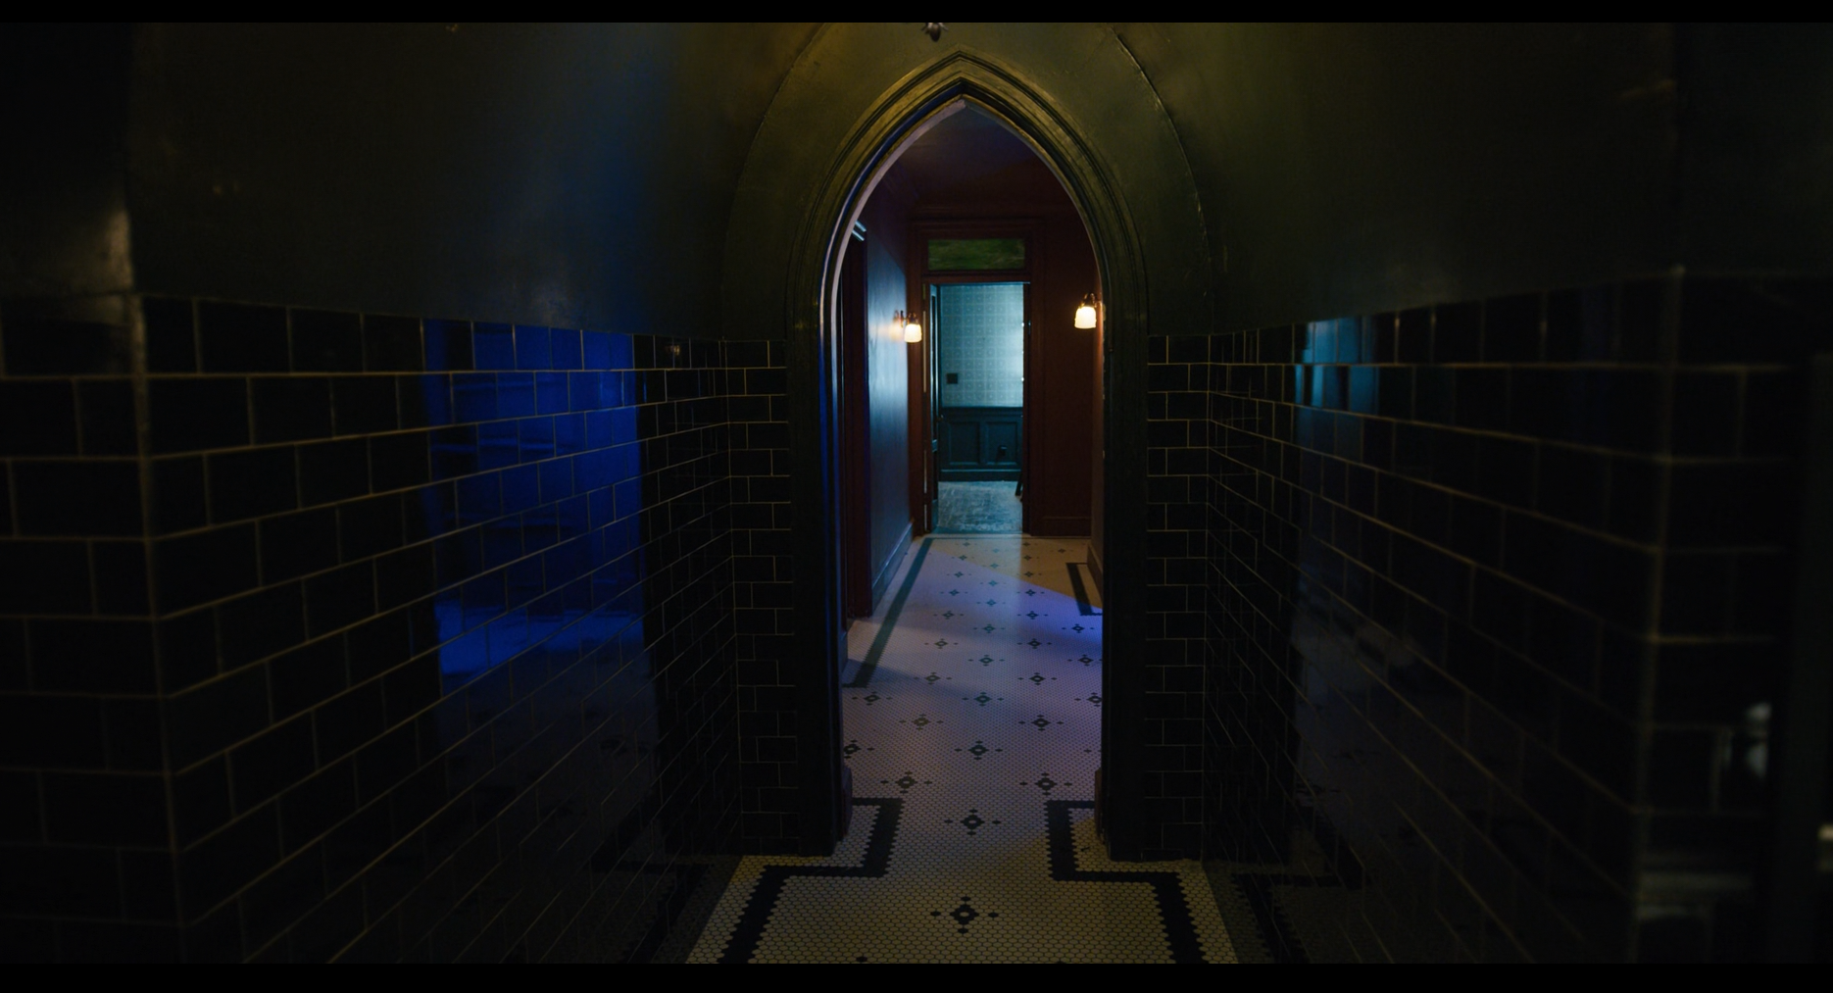
Trauma on the screen: The techniques utilised by Russian Doll (2019) to represent trauma
Background image 1. My screenshot (Russian Doll,2019)

Slide 2
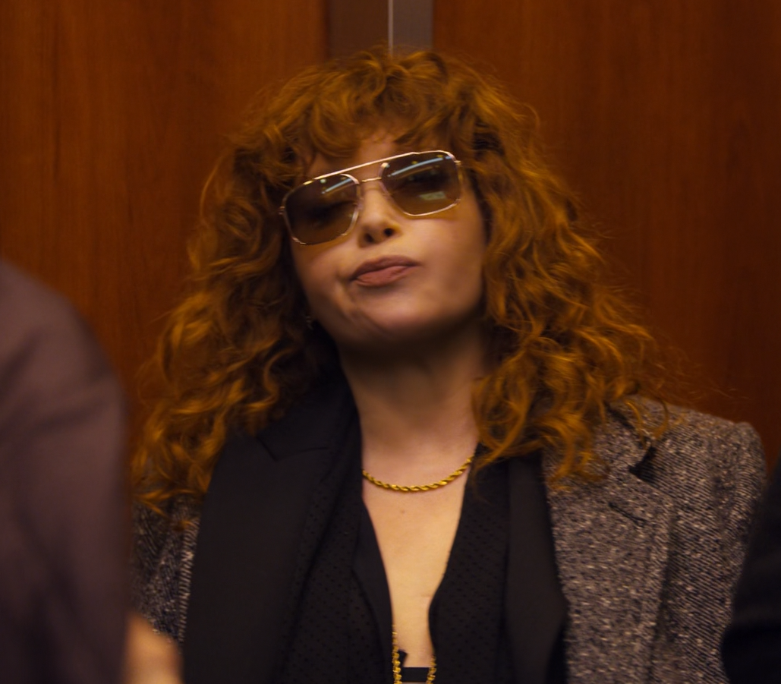
Russian Doll (2019)
Russian Doll (2019), is a Netflix series created by Natasha Lyonne, Leslye Headland, and Amy Poehler
The series explores the journey of confronting and beginning to heal from trauma, a story told through the main character, Nadia.
Russian Doll masterfully utilises unique narrative structures and stylistic choices to explore the complex and nonlinear elements of trauma.
Image 1. My screenshot of main character, Nadia, from episode 3 (Russian Doll,2019)

Slide 3
Reasons for research
Current Lack of Effective Media Representation of Trauma
I find that even in the modern day, honest and accurate representations of trauma in digital media that are also empathetic in their approach is lacking. Hodgin, N. and Thakkar, A. (2017) touch upon films depicting trauma as a spectacle in the name of the stories being more “impressive to behold”. I want to explore and celebrate Russian Doll for how it meets and goes beyond the above criteria
Discovering and Utilising the Techniques
I would like to be able to discover what techniques Russian Doll uses to achieve this, and hopefully implement those same or similar techniques in my future work

Slide 4
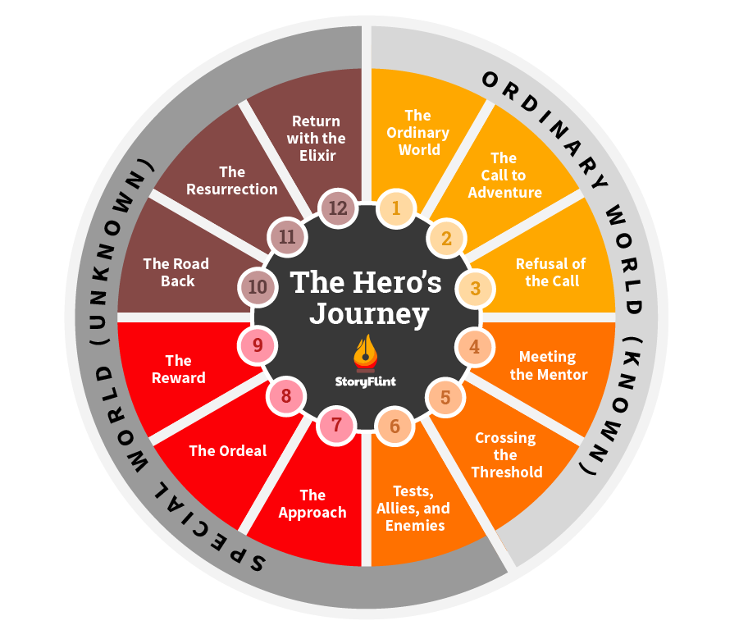
Narrative Structure of the Time Loop
Narrative Loop
Hero’s Journey
Nadia also loops through two steps of the hero’s journey narrative pattern often throughout the earlier episodes and continues to do so indirectly throughout the series
The “Refusal of the Call” step can be seen as Nadia refusing to engage and process her trauma
This disruption to the narrative is met with punishment, aka repeated deaths soon into her loops
Image 2. The 12 Steps of the Hero’s Journey, StoryFlint

Slide 5
Narrative Structure of the Time Loop
Ground Zero
Shaking of the narrative reflects the beginning of processing trauma
“if the material properties of film have the potential to shake and unhinge perceptual experience, then film also holds the potential to ‘repair’ itself, to move from the broken to the whole” (Quinlivan, D. 2014, p.10)
With trauma and notably addiction, it often take a “shake and unhinge” of someone’s life for them to finally take action towards healing
Such breaking of a film’s properties can result in a haptic type of communication

Slide 6
Narrative Structure of the Time Loop
Nadia’s Agency
It could be argued that Nadia always has agency, despite the time loop insinuating otherwise
The narrative begins progressing the more Nadia takes control of her agency
In turn, the narrative halts and loops itself when Nadia looses control of her agency, as shown in the montage where she partakes in vices without care

Slide 7
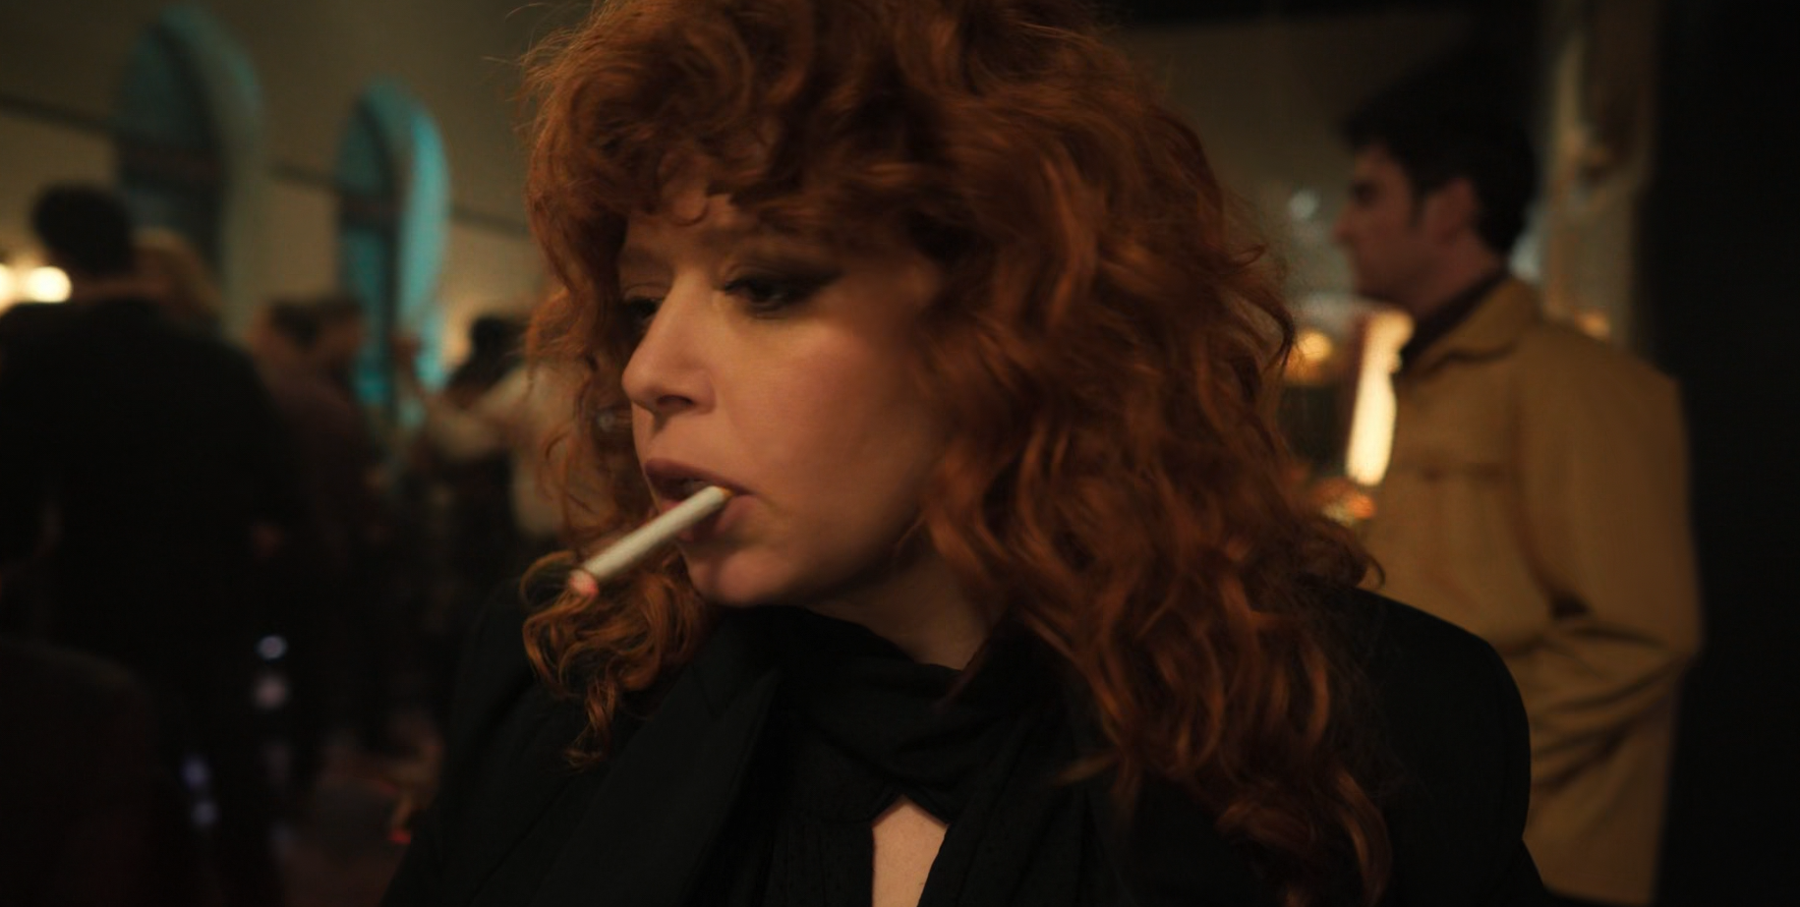
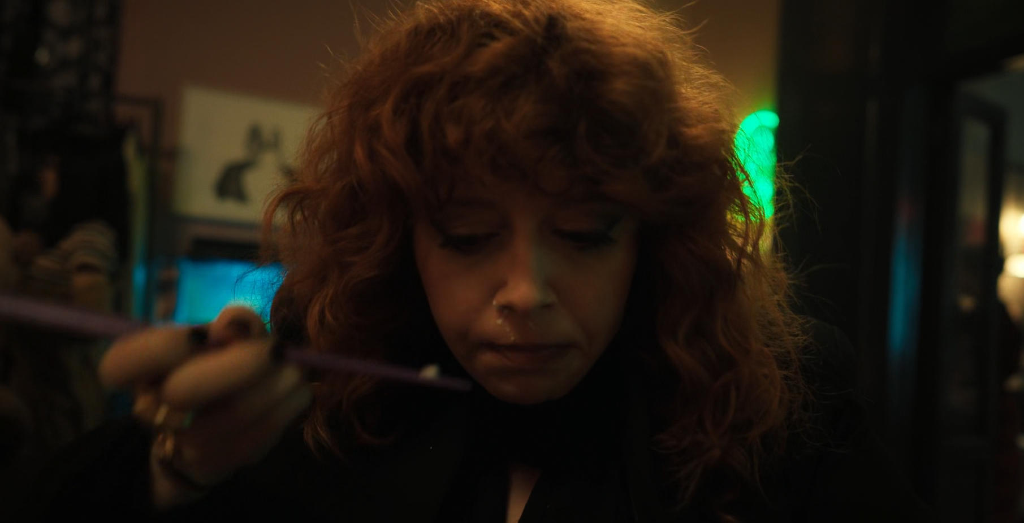
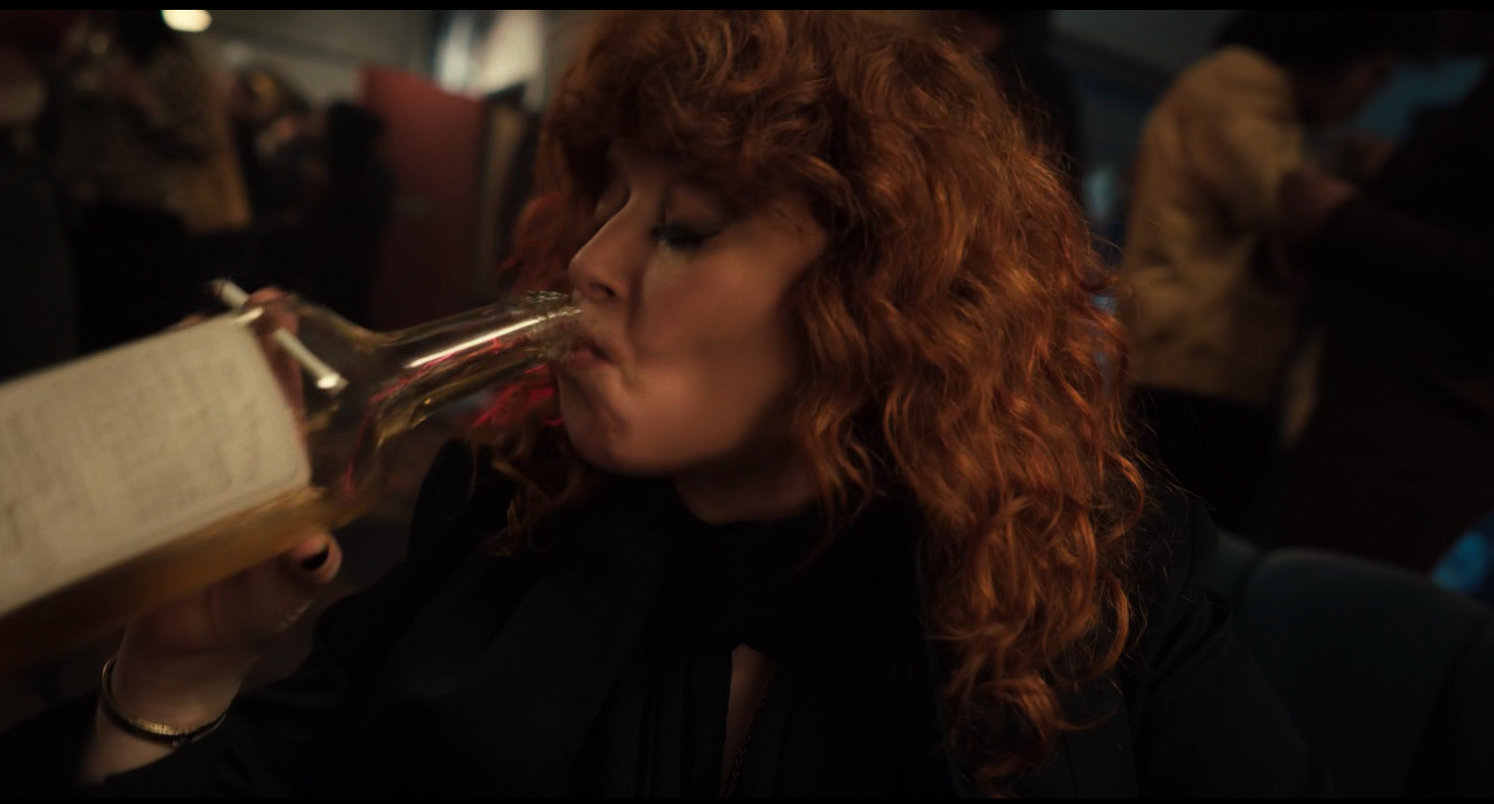
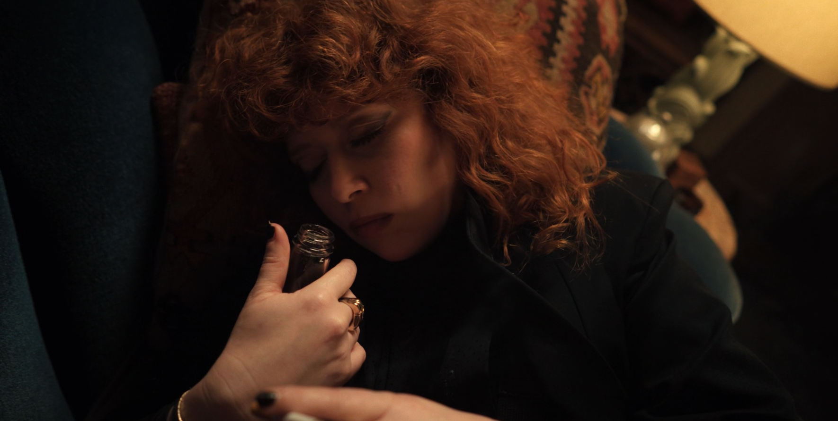
Editing Choices
‘Hip-hop montage’
The montage at her birthday party shows Nadia disconnected from herself, and attempting another “Refusal of the Call”
Graßl (2018) explores visual representation of drug use in film, and talks of the use of ‘hip-hop montages’ to convey repetitive, vivid actions
The montage is predicated by Maxine, a friend of Nadia, telling her that she “can’t leave, this is your party”. Nadia lets go of her agency in this moment, and the montage reflects that
Yet instead of this backstep being narratively punished by a death, Nadia wakes up the next morning and takes a step forward by asking her other friend, Lizzy, for help
Image 3, 4, 5, & 6. My screenshots of the ‘hip-hop montage’ from episode 2 (Russian Doll, 2019)

Slide 8
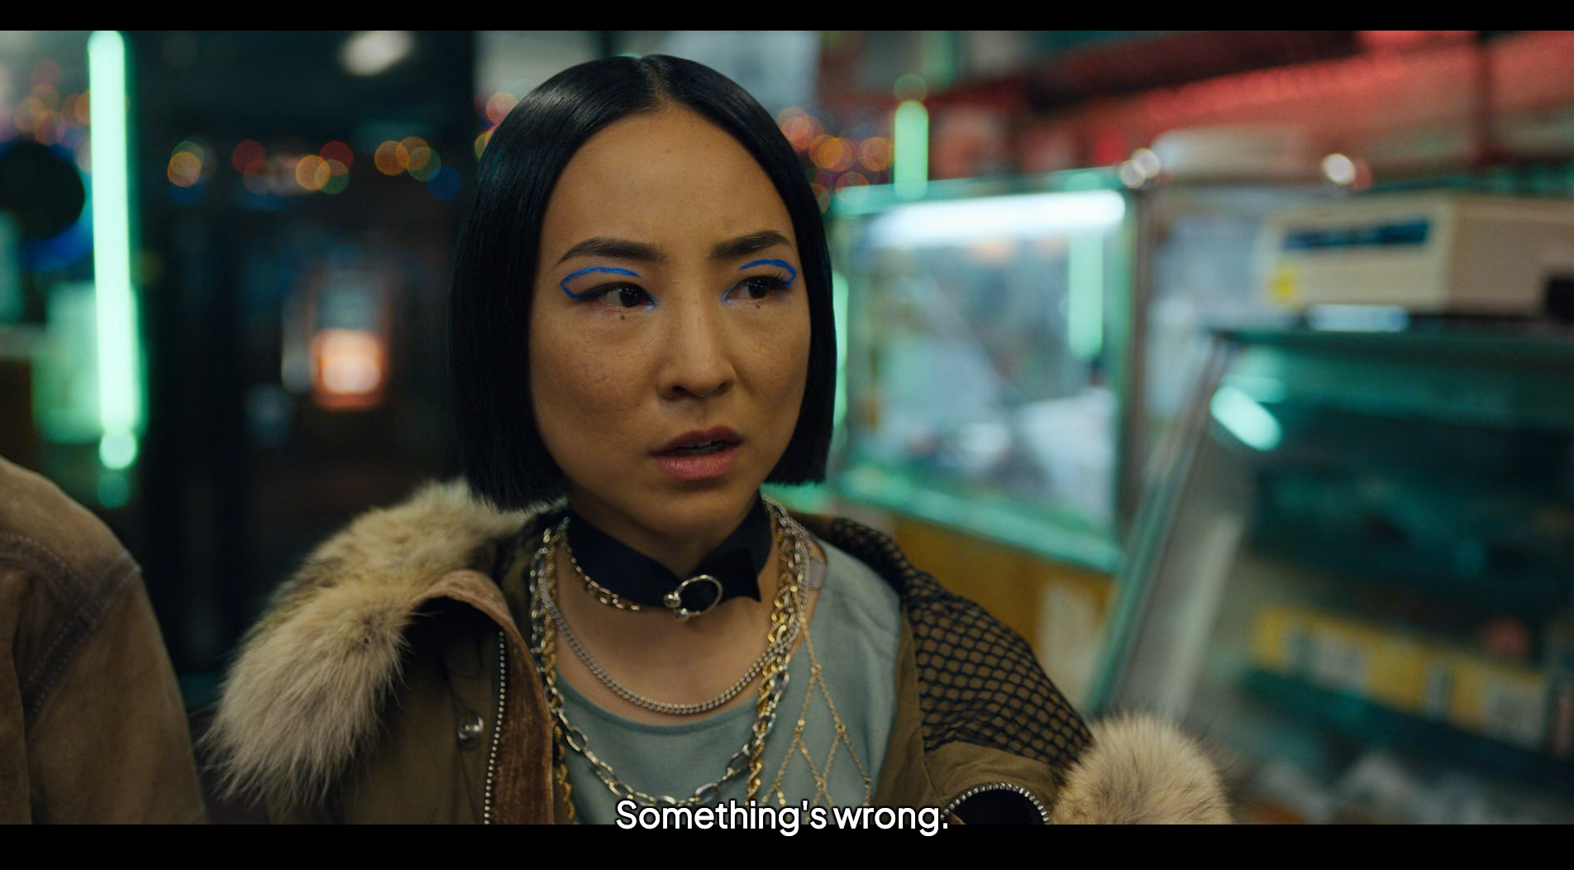
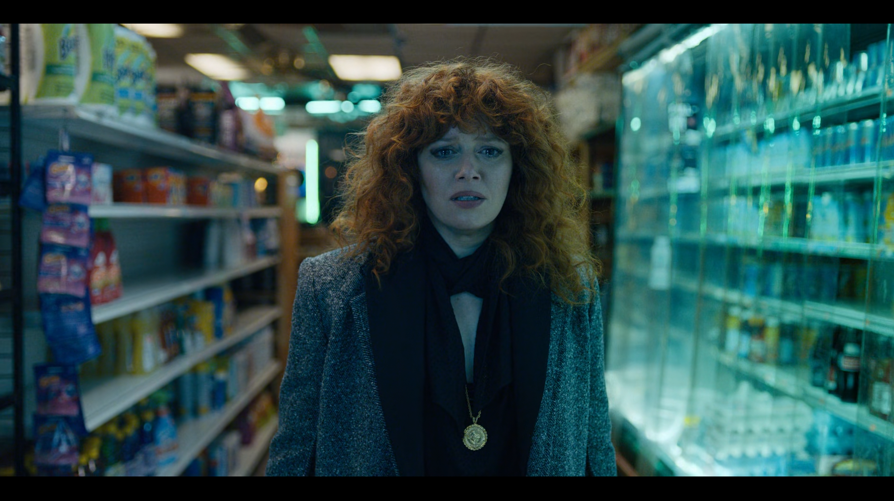
Editing Choices
Confronting your trauma too soon
In episode seven, Nadia’s younger self appears before her, representing Nadia’s trauma from her childhood
We are shown a show zooming in on Maxine as she watches Nadia, saying “Something’s wrong” before immediately cutting to Nadia forcing herself down the store aisle towards her younger self, towards her trauma
This cut immediately after Maxine’s statement conveys to the viewer that Nadia confronting her trauma her is wrong. It’s too soon, and not a safe environment for her to do so
Later in the episode, we are shown Nadia having a more positive confrontation with her trauma when she is more ready and feels safer
Image 7 & 8. My screenshots of the “something’s wrong” scene from episode 7 (Russian Doll, 2019)

Slide 9
Conclusion
The creators of Russian Doll told a story of trauma that is empathetic, raw, and healing, both for the characters of the show and, potentially, for the viewers.
Through their creative techniques, the creators managed to provide information to help the viewer understand what holds Nadia back and what allows her to proceed and begin her healing journey.

Slide 10
Further discussion
I would be curious to explore other creative techniques the creators of Russian Doll utilised such as their use of music, Mise-en-Scène, colour theory, and culture commentary
I find works such as Russian Doll great study pieces due to its depth and full use of the medium to convey complex themes
The second season of Russian Doll also has a lot to offer, and I feel they push the visual techniques even further than the first season

Slide 11
Images
Background image 1. Russian Doll (2019) [Screenshot] Available at: https://www.netflix.com.
Image 1. Russian Doll (2019) [Screenshot] Available at: https://www.netflix.com.
Image 2. 12 Steps of the Hero’s Journey, StoryFlint [Image] Available at: https://www.storyflint.com/blog/heros-journey-christopher-vogler
Image 3, 4, 5, 6, 7, & 8. Russian Doll (2019) [Screenshot] Available at: https://www.netflix.com.

Slide 12
Videos
Vid 1, 2, 3, & 4. “The Great Escape” Russian Doll (2019). Season 1, Episode 2. Netflix. Available at: https://www.netflix.com.
Vid 5 & 6. “The Way Out” Russian Doll (2019). Season 1, episode 7. Netflix. Available at: https://www.netflix.com.

Slide 13
References
Hodgin, N. and Thakkar, A. (2017) ‘Introduction: Trauma Studies, Film and the Scar Motif’, Springer eBooks, pp. 7. Available at: https://doi.org/10.1007/978-3-319-41024-1_1.
Quinlivan, D. (2014) ‘Film, healing and the body in crisis: a twenty-first century aesthetics of hope and reparation’, Screen, 55(1), pp. 103–117. Available at: https://doi.org/10.1093/screen/hjt053.
Hazen, M. (2020) ‘Exploring narrative complexity in Outer Wilds: A textual analysis on how user agency and a time-loop influence the narrative complexity’, BA. Thesis. Utrecht University. Available at: https://studenttheses.uu.nl/handle/20.500.12932/865
Cabeen, C. (2023) ‘Trauma Responses in Social Choreography: Accessing Agency and Opportunities for Healing through Mindful Embodiment’, Arts, 13(1), pp. 4–4. Available at: https://doi.org/10.3390/arts13010004.
Graßl, K. (2018) The representation of drugs in movies: narrative and social functions. Thesis. Available at: https://unipub.uni-graz.at/obvugrhs/2878997.
van der Kolk, B. (2014) The Body Keeps the Score: Brain, Mind, and Body in the Healing of Trauma. London: Penguin Books.

